Slide 1

Virtual learning
Back to school night
Donna Peyton

Slide 2
Introduction
Started teaching in 1988
I am the Latin teacher at Ridgeland High School
This is my 8th year at Ridgeland High School

Slide 3
Successful Learning Environment
Minimize distractions and background noises.
Please ensure the mic is muted.
Wear clothing appropriate for school.
Be sure that what is said or typed is kind and appropriate.

Slide 4
Schedule

Slide 5
Attendance
In order to be considered “present” for Virtual Learning, students must attend live meetings and/or complete classwork. If your student is unable to attend a live meeting, he or she may still be counted “present” as long as classwork due that day is submitted by 11:59 p.m. of the same day.

Slide 6
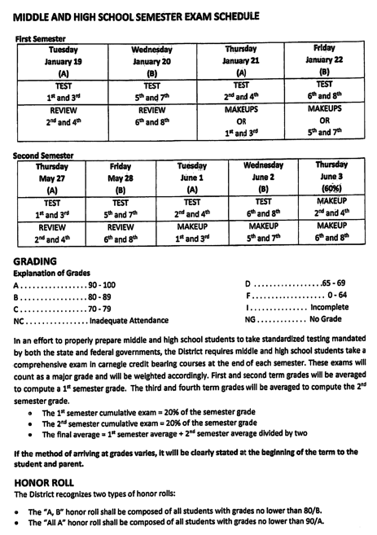
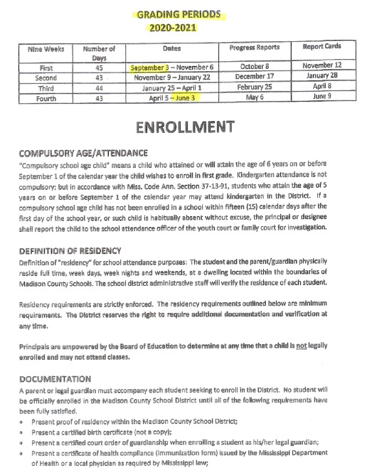
Grading Periods

Slide 7
Class
Virtual English III
Meets 12:10-1:00 on B days

Slide 8
Virtual Student Meals
5 Day Meal Packs will be distributed at your child’s school every Monday from 10am – 12am.
Meals are currently FREE, but they must be pre-ordered.
You can find more information at:
www.madison-schools.com/virtuallearning

Slide 9
Contact Information
Our goal is to maintain an open line of communication as we work together to provide the best education possible for your child.
Please feel free to contact me at dpeyton@madison-schools.com; all work can be found on Canvas
More information regarding Virtual Learning, including contact information, can be found at www.madison-schools.com/virtuallearning

Slide 10

Thank you for entrusting us with the education of your child. We look forward to a great semester!

